Slide 1
LOG SETTER
Easy way to arrange logs

Slide 2

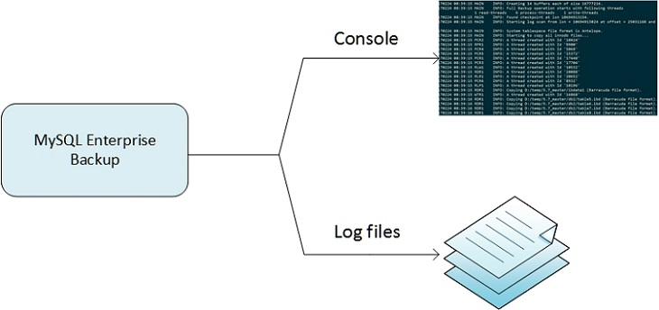
What are logs?
A log file is a file that keeps a registry of events, processes, messages and communication between various communicating software applications and the operating system. Every executable file produces a log file where all activities are noted. To look after every single activity done by client is a very difficult job.
Just like in any other programming language software requires logs so that if that software crashes at some point we can track by the help of logs. Similarly, in cloud computing the companies have to keep tracks on the logs. They usually write it in an excel sheet manually. I have made this software to solve this problem and reduce the working time. To make this software I have used only java language which would make it work on any platform. It is an offline application. Regex played very important role in this project and also apache poi for making an excel sheet.

Slide 3
Log file analysis
A log file analysis often involves processing large amounts of data, particularly for larger websites. For small projects with few page views, log files could be read and analyzed manually.
Aspects of a log file analysis :-
IP Address and host name
Country or region of origin
Browser and operating system used
Direct access by the user or reference from another website or advertising measure
The user status (that is password accepted or rejected).
Duration and number of pages visited by the user
Page on which the user has left the website again

Slide 4
Advantages of log analysis
Automatic logging of crawlers: Log files record every visit to the web server automatically. This also includes search engine bots. This provides valuable insights regarding bot behavior on websites.
No JavaScript or cookies required: Unlike web analysis tools, no JavaScript codes or cookies are required for log file analysis. This makes the analysis less susceptible to technical problems. Log files can also be recorded even when users block web analytics tools.
Realignment of historical data: web servers continuously record log files. If the files are saved again and again, they can be evaluated flexibly.
Data regarding website usage remain within your own network: if the log file analysis is carried out internally, and is not outsourced to an external provider, the data remains in your own network.

Slide 5
Disadvantages of log analysis
Caching and proxies: since a log file can only record data that is created by direct server access, all accesses that occur via the cache memory of the browser and via proxy servers are not included in the protocol.
Regular updates necessary: To ensure that log files always deliver correct figures, the webmaster has to continuously update the software used for collecting the data. This results in additional maintenance costs.
Additional storage requirements: The amount of data required for log files can quickly increase in case of high visitor traffic, as every access to the server is logged automatically. Regular log file analyses of large websites therefore requires additional storage resources.
Complex data preparation for large amounts of data: for log file analysis, the individual log files must first be entered into a data preparation program. This means extra work, especially for many data sets.

Slide 6
what is Regex ?
A regular expression (sometimes called a rational expression) is a sequence of characters that define a search pattern, mainly for use in pattern matching with strings, or string matching, i.e. “find and replace”-like operations.
Regular expressions are a generalized way to match patterns with sequences of characters. It is used in every programming language like C++, Java and Python.
Character Classes A character class matches any one of a set of characters. It is used to match the most basic element of a language like a letter, a digit, space, a symbol etc./s : matches any whitespace characters such as space and tab /S : matches any non-whitespace characters /d : matches any digit character /D : matches any non-digit characters /w : matches any word character (basically alpha-numeric) /W : matches any non-word character /b : matches any word boundary (this would include spaces, dashes, commas, semi-colons, etc)

Slide 7
Regex pattern used in project
These are some of the pattern used in the project to select certain important part:-
([a-zA-Z0-9\\s\\:]+)\\sip-([0-9\\-]+)\\ssshd\\[([0-9]+)\\]\\:\\s([a-zA-Z\\s]+)\\sfor\\s([a-zA-Z0-9\\s\\.]+)\\sfrom\\s([0-9\\.]+)\\sport\\s([0-9]+)\\sssh2
The java compiler will only select the certain type of file that is in the brackets.
([a-zA-Z0-9\\s\\:]+)\\sip\\-([0-9\\-]+)\\ssshd\\[([0-9]+)\\]\\:\\s([a-zA-Z\\_\\&]+)\\(sshd:session\\)\\:\\ssession\\s([a-zA-Z]+)\\sfor\\suser\\s([a-zA-Z0-9\\-\\*\\^\\&\\@]+)

Slide 8
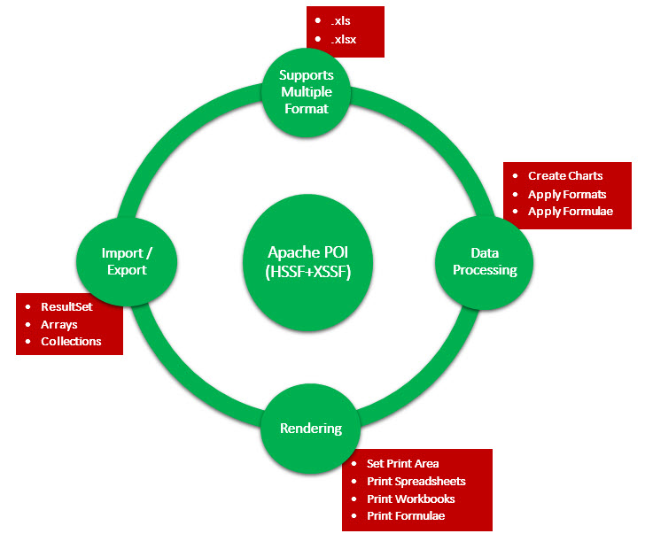
Apache poi
Apache POI is a popular API that allows programmers to create, modify, and display MS Office files using Java programs. It is an open source library developed and distributed by Apache Software Foundation to design or modify Microsoft Office files using Java program. It contains classes and methods to decode the user input data or a file into MS Office documents.

Slide 9
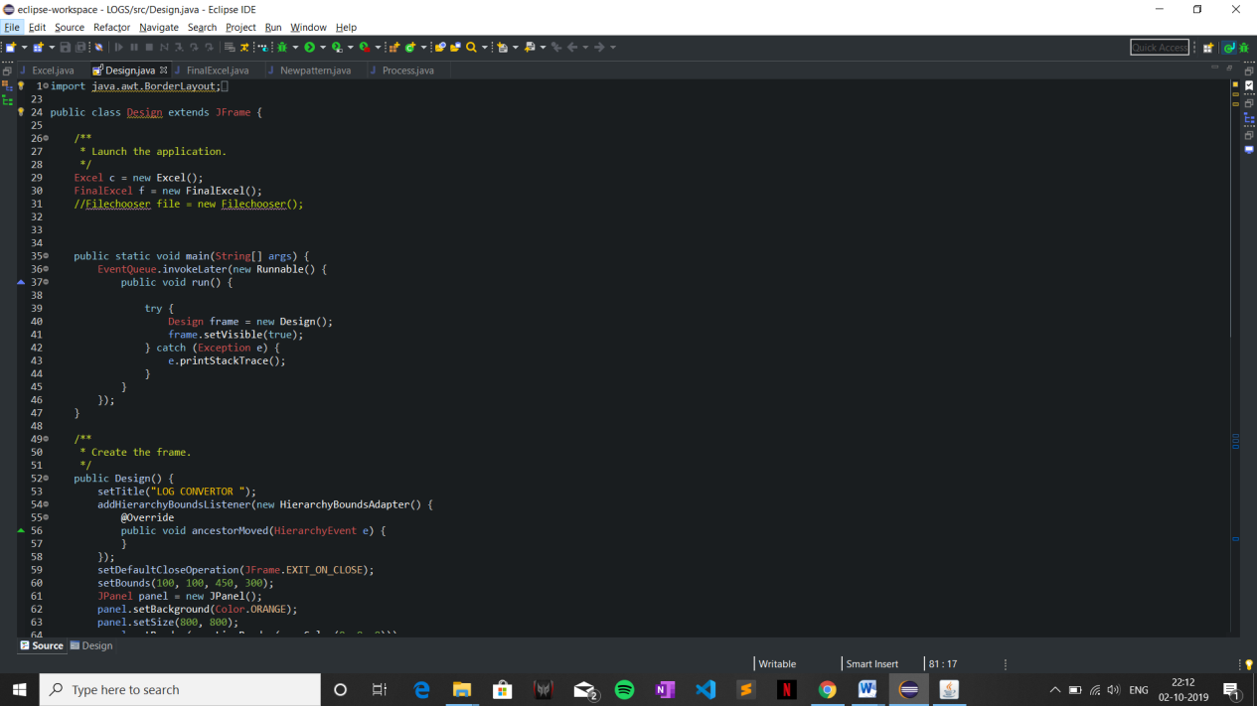
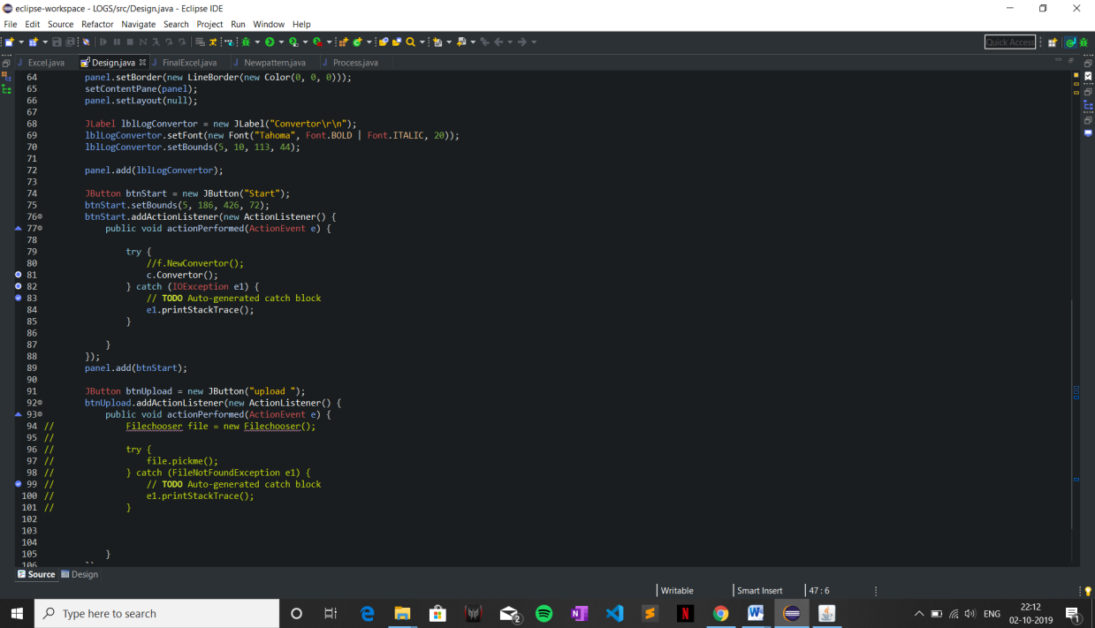
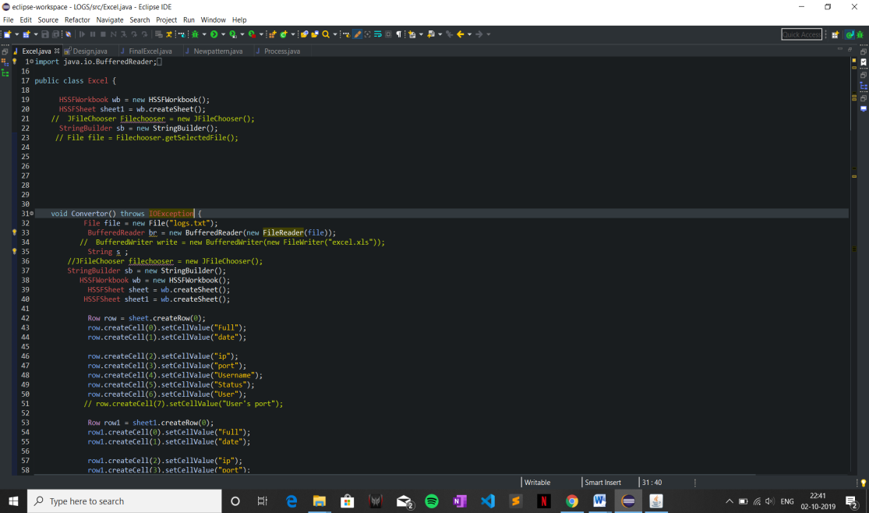
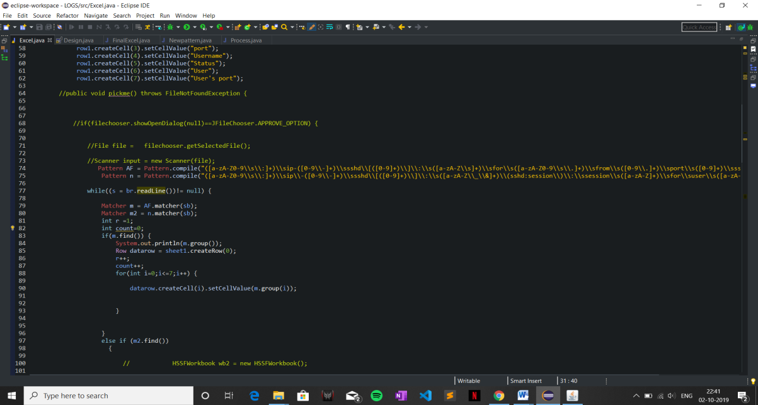
Some of the screenshots

Slide 10
Thank you
By Dev Gaur
Cse – b 3rd Year
Roll no. 114

